Slide 1
Annual Epidemiological Spotlight on STIs in Yorkshire and Humber
2024 data

Slide 2
About the UK Health Security Agency
The UK Health Security Agency (UKHSA) was formally established on 1 April 2021.
The UK Health Security Agency (UKHSA) is responsible for protecting every member of every community from the impact of infectious diseases, chemical, biological, radiological and nuclear incidents and other health threats.
We provide intellectual, scientific and operational leadership at national and local level, as well as on the global stage, to make the nation’s health secure.
UKHSA is an executive agency, sponsored by the Department of Health and Social Care.

Slide 3
Impact of the Coronavirus pandemic
The 2020 COVID-19 pandemic accelerated the reconfiguration of sexual health services to increase access to STI testing online and via telephone consultations.
Testing and diagnoses of new STIs decreased during the pandemic.
Data for 2022 suggests that those decreases were temporary.
Numbers and rates of some STIs are now higher than in the last pre-pandemic year (2019).

Slide 4
Summary of 2024 data for Yorkshire and Humber residents
28,273 new STIs diagnosed
New STI diagnosis rate: 505 per 100,000 population
The number of new STIs diagnosed in Yorkshire and Humber residents decreased by 14% between 2023 and 2024. Changes were seen in the numbers of the five major STIs: syphilis increased by 5%, gonorrhoea decreased by 28%, chlamydia decreased by 15%, genital herpes decreased by 3% and genital warts decreased by 9%
Chlamydia detection rate in women aged 15-24 was 1,693 per 100,000 pop. (aim = 3,250)
19% of new STI diagnoses (excl. chlamydia reported via CTAD) were in gay, bisexual and other men who have sex with men (GBMSM) (67% of syphilis, 40% of gonorrhoea)
15-24 year olds accounted for 47% of new STI diagnoses
Only 1.2% of new STIs were in the Black Caribbean ethnic group, who have the highest rate of new STIs (1,284 per 100,000 pop.)
The White ethnic group has the highest number of new STI diagnoses (79.7%)
Majority of those diagnosed with a new STI are UK-born (86%)

Slide 5
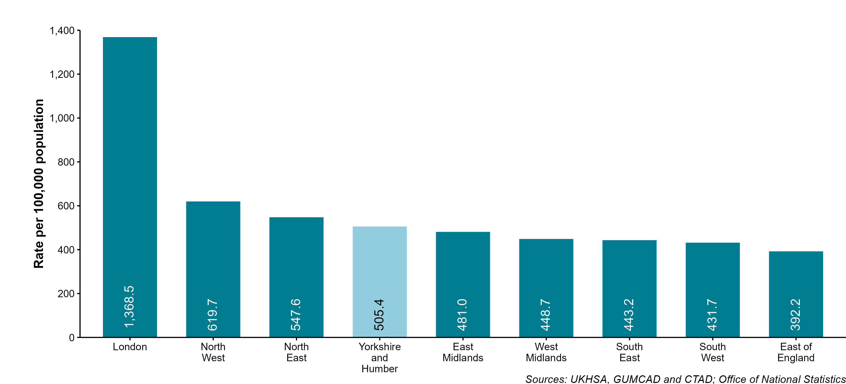
Figure 1: New STI diagnosis rates by UKHSA region of residence, England, 2024

Slide 6
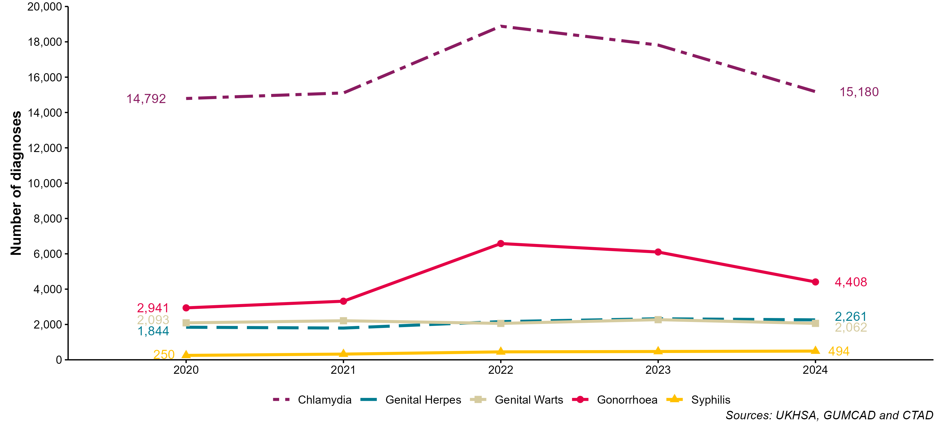
Figure 2: Number of diagnoses of the 5 main STIs, Yorkshire and Humber residents, 2020 to 2024
Increases or decreases in STI diagnoses may reflect changes in testing and/or vaccination practices. Increases in gonorrhoea diagnoses may be due to the increased use of highly sensitive nucleic acid amplification tests (NAATs) and additional screening of extra-genital sites in GBMSM. Decreases in genital wart diagnoses may be due to a moderately protective effect of HPV-16/18 vaccination. Increases in genital herpes diagnoses may be due to the use of more sensitive NAATs. Increases or decreases may also reflect changes in testing practices.

Slide 7
Table 1: Percentage change in new STI diagnoses, Yorkshire and Humber residents
Diagnoses | 2024 | Percentage change 2020 to 2024 | Percentage change 2023 to 2024
Chlamydia | 15,180 | 3% | -15%
Genital Herpes | 2,261 | 23% | -3%
Genital Warts | 2,062 | -1% | -9%
Gonorrhoea | 4,408 | 50% | -28%
Syphilis | 494 | 98% | 5%
Other | 3,868 | 43% | 2%
All new STIs | 28,273 | 15% | -14%
Increases or decreases in STI diagnoses may reflect changes in testing and/or vaccination practices. Increases in gonorrhoea diagnoses may be due to the increased use of highly sensitive nucleic acid amplification tests (NAATs) and additional screening of extra-genital sites in GBMSM. Decreases in genital wart diagnoses may be due to a moderately protective effect of HPV-16/18 vaccination. Increases in genital herpes diagnoses may be due to the use of more sensitive NAATs. Increases or decreases may also reflect changes in testing practices.

Slide 8
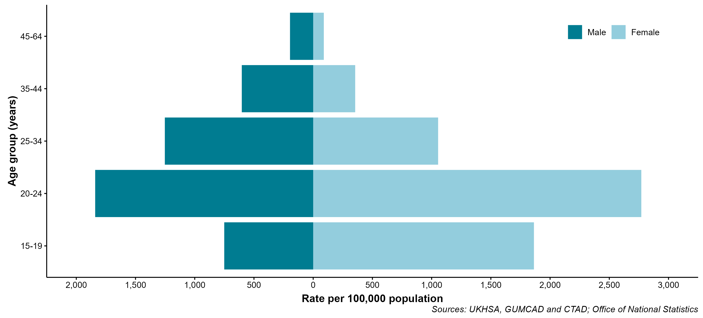
Figure 3: Rates of new STIs per 100,000 Yorkshire and Humber residents by age group* and gender, 2024
* The gender and age group chart is restricted to those aged 15-64 years as information about STIs in those aged <15 years is considered highly sensitive. Analyses specific to this group are not provided in routine outputs. Rates for those aged 65 or older are withheld to ensure that no deductive disclosure is possible for the <15 years age group. The proportion of STIs in those aged <15 years or older than 64 years is very low. Rates elsewhere in this slide set which are not specified as age-restricted include all diagnoses regardless of age at diagnosis.

Slide 9
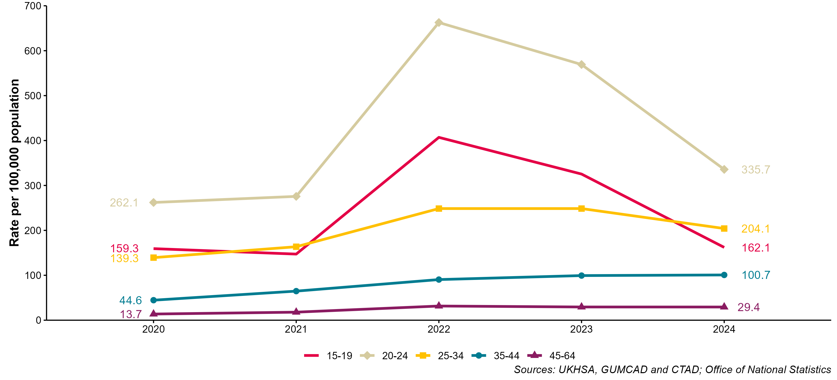
Figure 4: Rates of gonorrhoea per 100,000 Yorkshire and Humber residents by age group* (for those aged 15 to 64 years only), 2020 to 2024
* Age-specific rates are shown for those aged 15 to 64 years only.

Slide 10
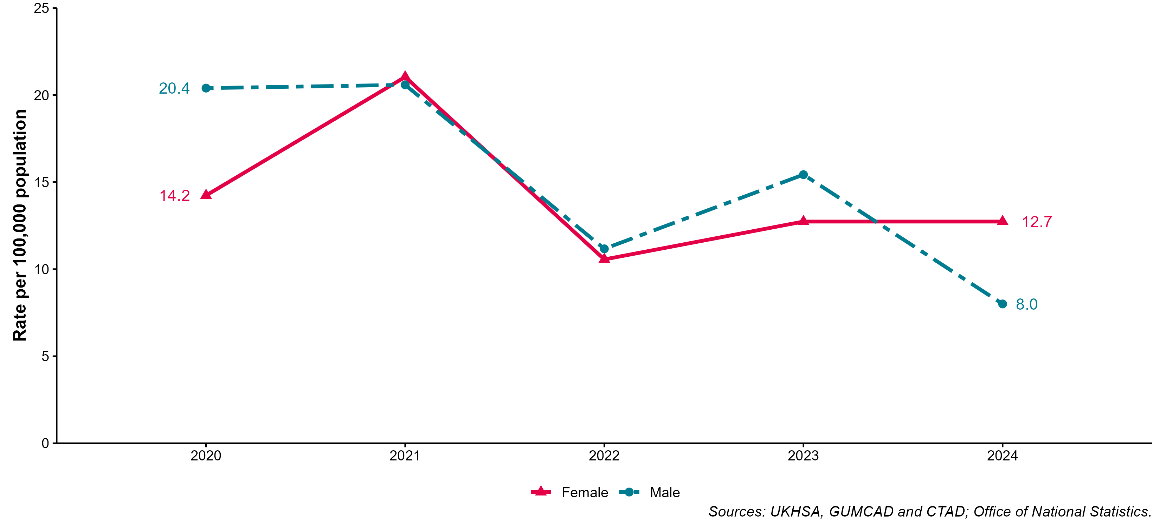
Figure 5: Rates of genital warts per 100,000 Yorkshire and Humber residents aged 15 to 19 years by gender, 2020 to 2024

Slide 11
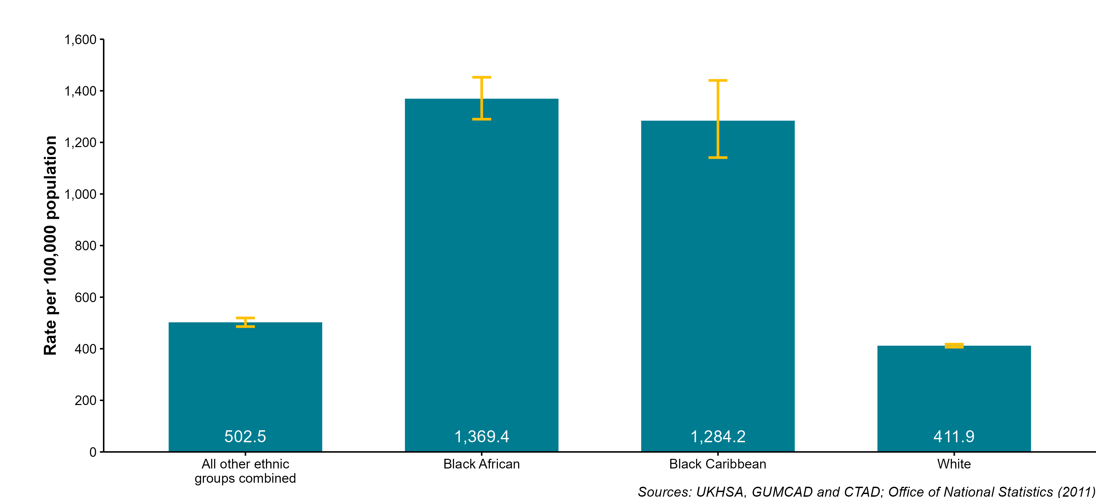
Figure 6: Rates of new STIs per 100,000 Yorkshire and Humber residents by ethnic group, 2024
Confidence Intervals were calculated using Byar's method for numerators >= 10. For small numerators Byar's method is less accurate and so an exact method based on the Poisson distribution is used.

Slide 12
Table 2: Percentage of Yorkshire and Humber residents diagnosed with a new STI by ethnic group, 2024
Ethnic group | Number | Percentage (excluding unknown)
All other ethnic groups combined | 3,503 | 14.5%
Black African | 1,108 | 4.6%
Black Caribbean | 292 | 1.2%
White | 19,275 | 79.7%
unknown | 4,095

Slide 13
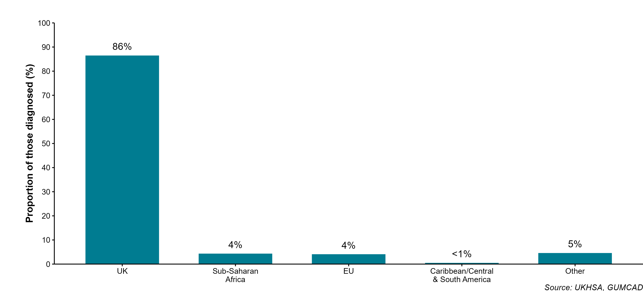
Figure 7: Percentage of Yorkshire and Humber residents diagnosed with a new STI by world region of birth* 2024
* Data on country of birth is not collected by CTAD. All information about world region of birth is based on diagnoses made in specialist and non-specialist services which report to GUMCAD.

Slide 14
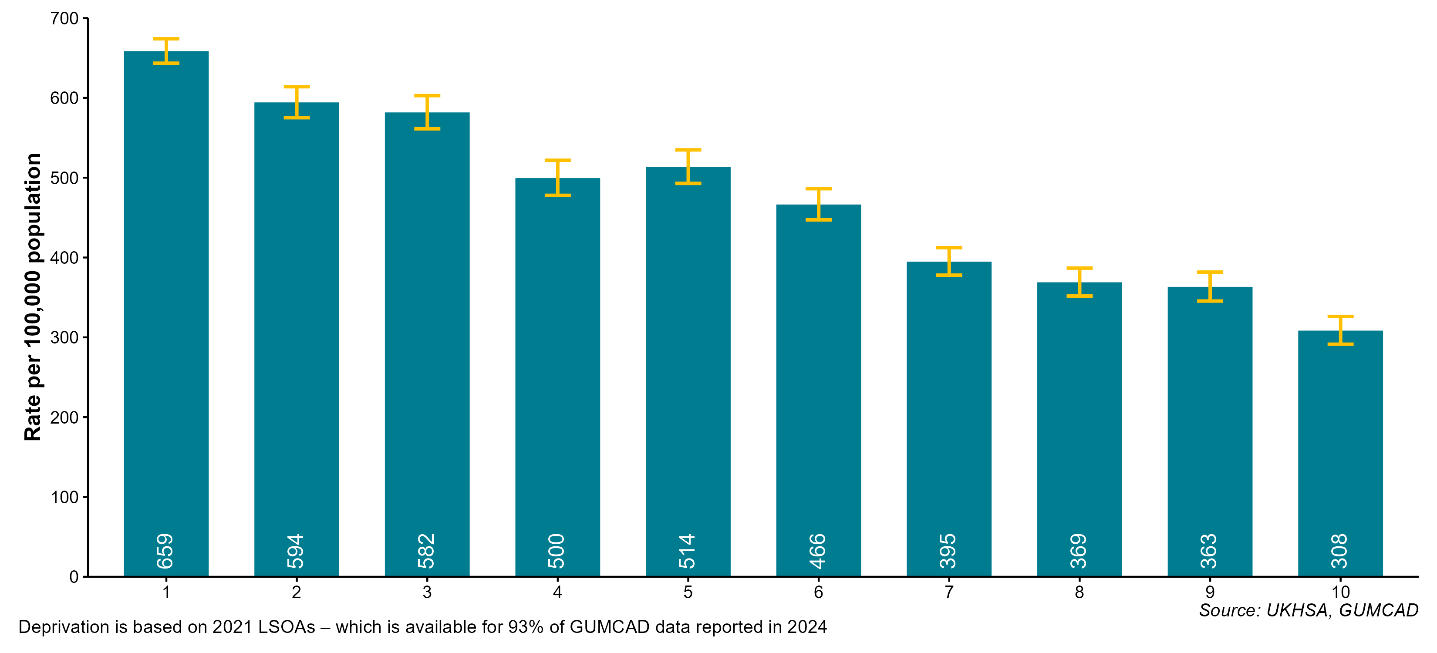
Figure 8: Rates of new STIs per 100,000 Yorkshire and Humber residents by decile of deprivation*, 2024
* Deciles run from 1 to 10 in order of decreasing deprivation, with 1 being the decile for the most deprived areas. Confidence Intervals were calculated using Byar's method for numerators >= 10. For small numerators Byar's method is less accurate and so an exact method based on the Poisson distribution is used.

Slide 15
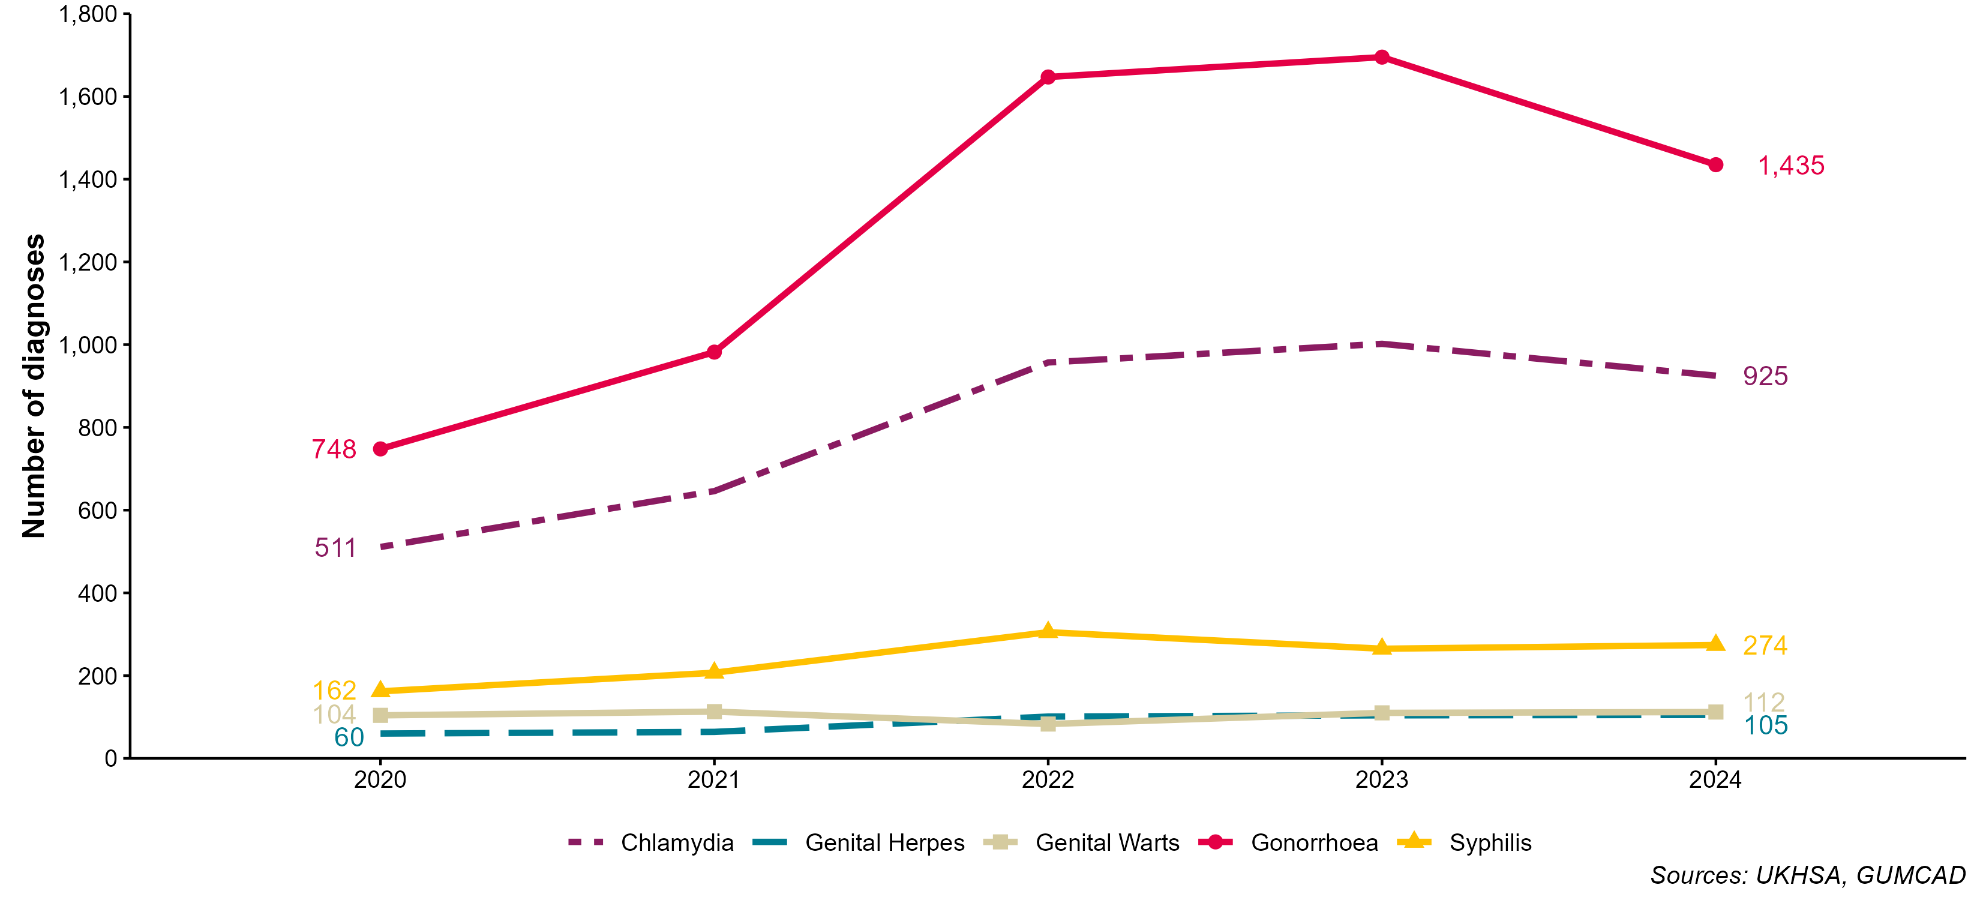
Figure 9: Diagnoses of the 5 main STIs among GBMSM* Yorkshire and Humber residents, 2020 to 2024
* Data on sexual orientation is not collected by CTAD. All analyses of GBMSM are based on diagnoses made in specialist and non-specialist services which report to GUMCAD and exclude chlamydia diagnoses via online services. GBMSM include all males whose sexual orientation was recorded as homosexual or bisexual at the date of diagnosis.
Increases or decreases in STI diagnoses may reflect changes in testing and/or vaccination practices including use of highly sensitive nucleic acid amplification tests (NAATs) and additional screening of extra-genital sites in GBMSM (see footnotes for figure 2 for more information).

Slide 16
Table 3: Percentage change in new STI diagnoses in GBMSM* residents in Yorkshire and Humber
Diagnoses | 2023 | 2024 | Percentage change 2023 to 2024
Chlamydia | 1,002 | 925 | -8%
Genital Herpes | 104 | 105 | 1%
Genital Warts | 110 | 112 | 2%
Gonorrhoea | 1,695 | 1,435 | -15%
Syphilis | 265 | 274 | 3%
Other | 330 | 376 | 14%
All new STIs | 3,506 | 3,227 | -8%
* Data on sexual orientation is not collected by CTAD. All analyses of GBMSM are based on diagnoses made in specialist and non-specialist services which report to GUMCAD and exclude chlamydia diagnoses via online services. GBMSM include all males whose sexual orientation was recorded as homosexual or bisexual at the date of diagnosis.
Increases or decreases in STI diagnoses may reflect changes in testing and/or vaccination practices including use of highly sensitive nucleic acid amplification tests (NAATs) and additional screening of extra-genital sites in GBMSM (see footnotes for figure 2 for more information).

Slide 17
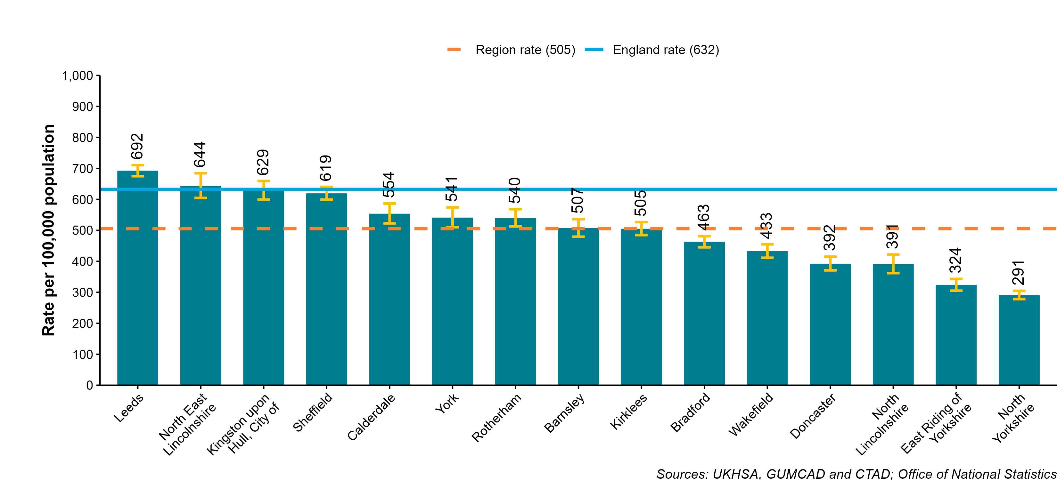
Figure 10: Rate of new STI diagnoses per 100,000 Yorkshire and Humber residents by upper tier local authority of residence, 2024
Confidence Intervals were calculated using Byar's method for numerators >= 10. For small numerators Byar's method is less accurate and so an exact method based on the Poisson distribution is used.

Slide 18
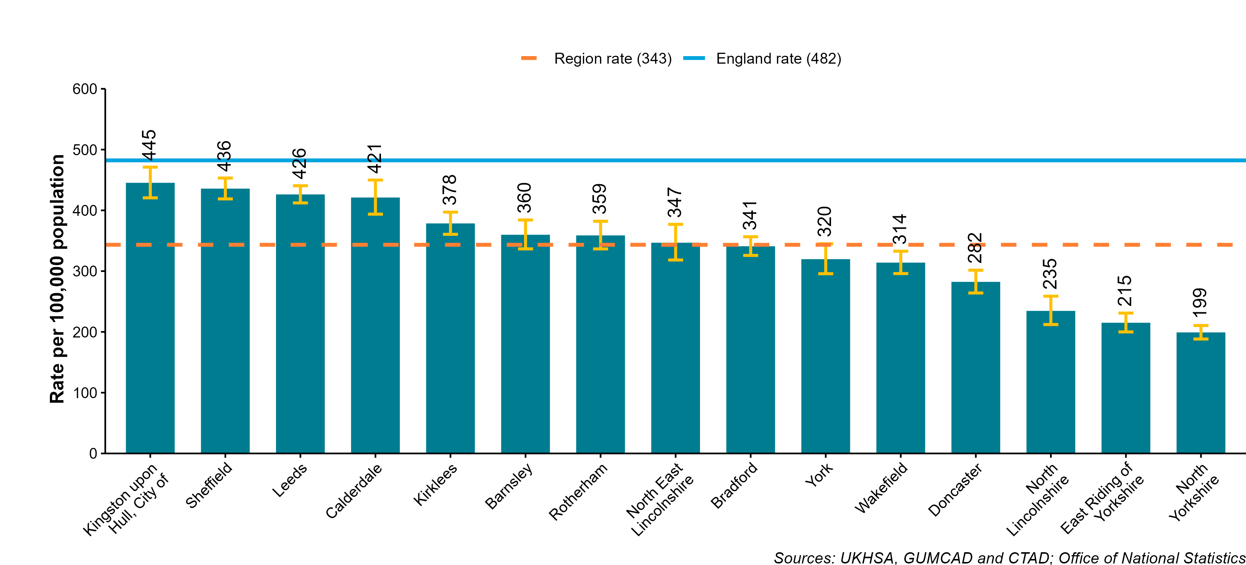
Figure 11: Rate of new STI diagnoses (excluding chlamydia diagnoses in residents aged under 25 years) per 100,000 Yorkshire and Humber residents by upper tier local authority of residence, 2024
Confidence Intervals were calculated using Byar's method for numerators >= 10. For small numerators Byar's method is less accurate and so an exact method based on the Poisson distribution is used.

Slide 19
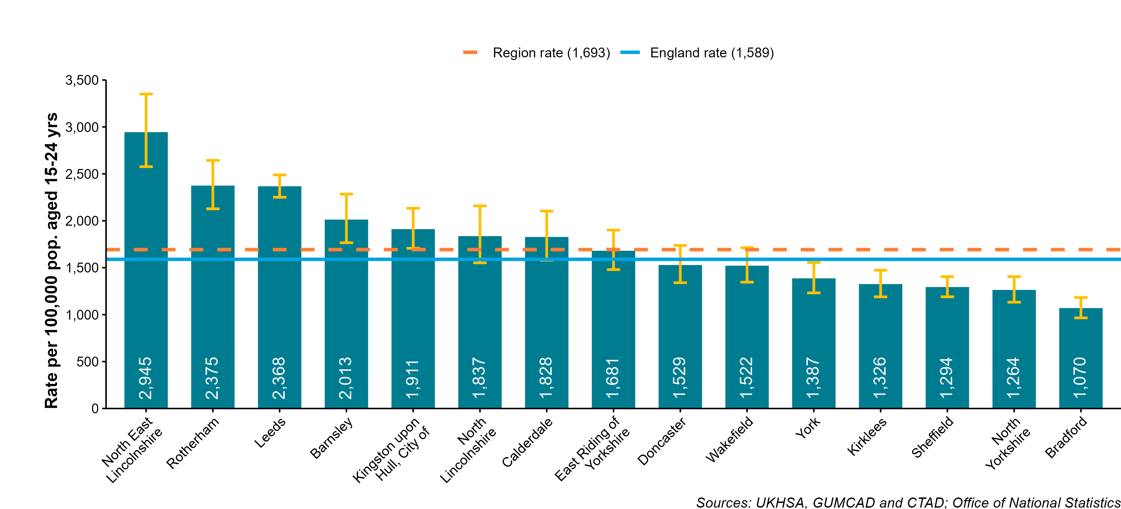
Figure 12: Chlamydia detection rate per 100,000 female Yorkshire and Humber residents aged 15 to 24 years by upper tier local authority of residence, 2024
UKHSA recommends that local areas should be working towards achieving a chlamydia detection rate no lower than 3,250 per 100,000 among individuals aged 15 to 24 years. Confidence Intervals were calculated using Byar's method for numerators >= 10. For small numerators Byar's method is less accurate and so an exact method based on the Poisson distribution is used.

Slide 20
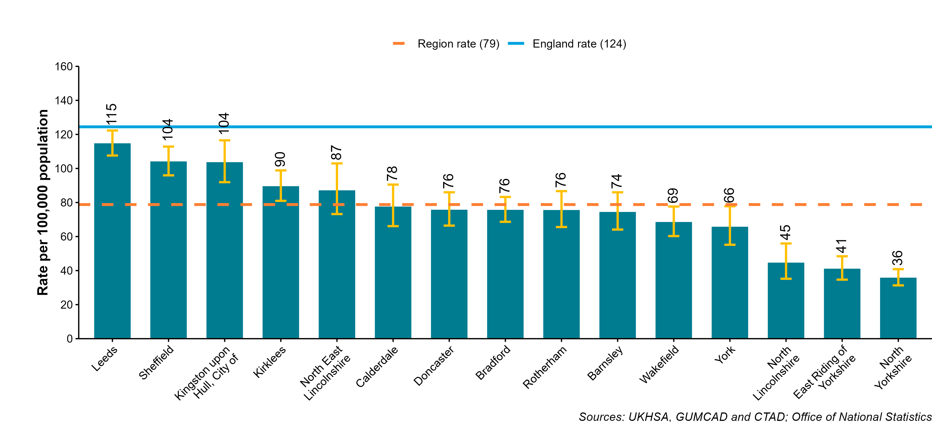
Figure 13: Rate of gonorrhoea diagnoses per 100,000 Yorkshire and Humber residents by upper tier local authority of residence, 2024
Confidence Intervals were calculated using Byar's method for numerators >= 10. For small numerators Byar's method is less accurate and so an exact method based on the Poisson distribution is used.

Slide 21
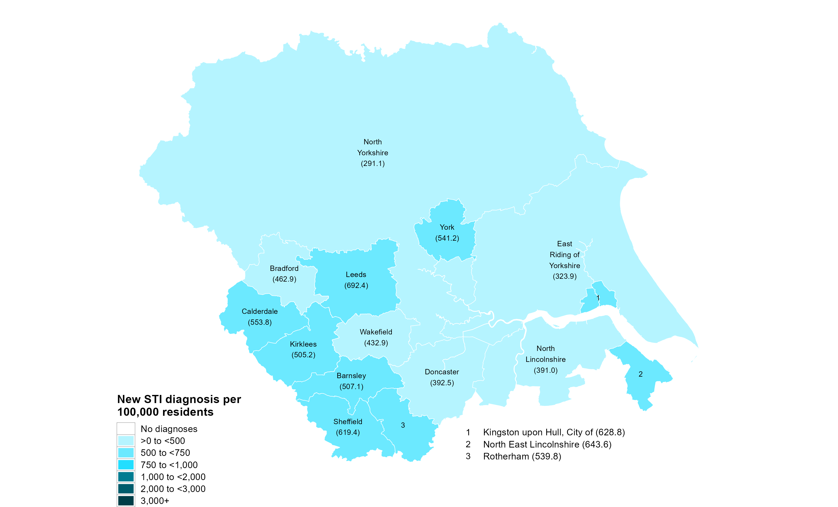
Figure 14: Map of new STI rates per 100,000 Yorkshire and Humber residents by upper tier local authority, 2024

Slide 22
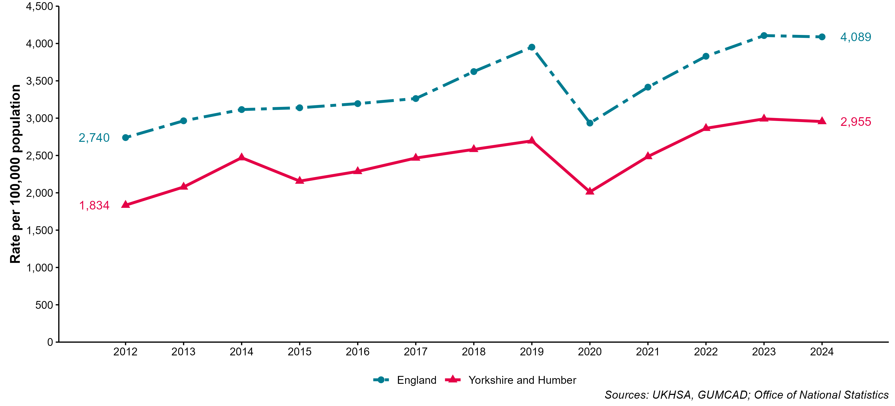
Figure 16: STI testing rate (excluding chlamydia in under 25 year olds) per 100,000 Yorkshire and Humber residents aged 15 to 64 years, 2012 to 2024

Slide 23
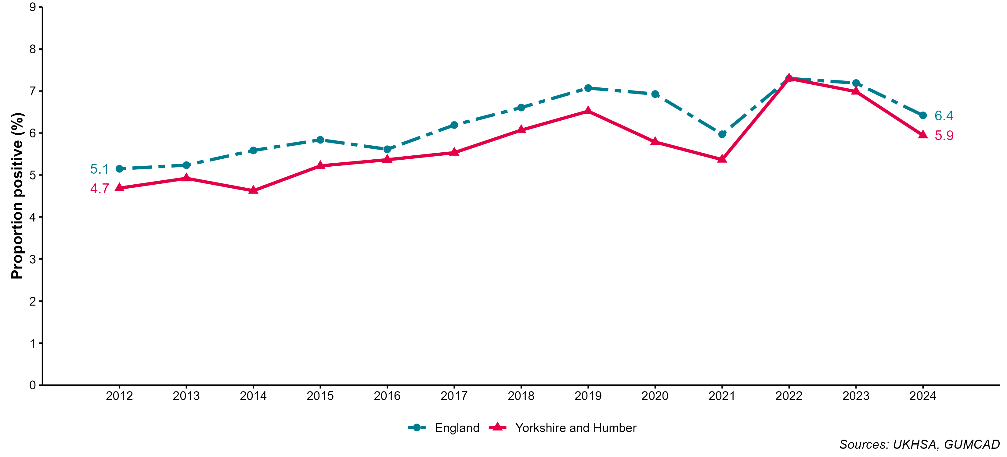
Figure 17: STI testing positivity rate* (excluding chlamydia in under 25 year olds) in Yorkshire and Humber residents, 2012 to 2024
* The numerator for the STI testing positivity rate now only includes infections which are also included in the denominator. These are: chlamydia (excluding diagnoses in those aged under 25 years), gonorrhoea, syphilis and HIV. Up to 2018 (data for 2017) it included all new STIs.

Slide 24
Table 4: Number of diagnoses of new STIs by UKHSA region of residence, data source and data subset 2024
UKHSA region of residence | GUMCAD | GUMCAD | CTAD** | Total
UKHSA region of residence | Specialist SHSs | Non-specialist SHSs* | CTAD** | Total
East Midlands | 13,865 | 5,900 | 4,244 | 24,009
East of England | 17,674 | 2,317 | 6,551 | 26,542
London | 87,381 | 11,044 | 23,995 | 122,420
North East | 10,121 | 1,722 | 3,004 | 14,847
North West | 33,672 | 4,248 | 9,175 | 47,095
South East | 29,777 | 2,455 | 8,472 | 40,704
South West | 17,434 | 2,856 | 4,797 | 25,087
West Midlands | 19,125 | 4,566 | 3,618 | 27,309
Yorkshire and Humber | 20,263 | 1,671 | 6,339 | 28,273
UK (not England or Wales) |  |  | 3 | 3
* New STI diagnoses from enhanced GPs reporting to GUMCAD are included in the ‘Non-specialist sexual health services (SHSs)’ total. ** CTAD collects data on chlamydia only.

Slide 25
Table 5: Number of diagnoses of the 5 main STIs in Yorkshire and Humber by STI, data source and data subset 2024
5 main STIs | GUMCAD | GUMCAD | CTAD** | Total
5 main STIs | Specialist SHSs | Non-specialist SHSs* | CTAD** | Total
Chlamydia | 8,075 | 766 | 6,339 | 15,180
Genital Herpes | 2,253 | 8 |  | 2,261
Genital Warts | 2,046 | 16 |  | 2,062
Gonorrhoea | 3,539 | 869 |  | 4,408
Syphilis | 494 | 0 |  | 494
* Diagnoses from enhanced GPs reporting to GUMCAD are included in the ‘Non-specialist sexual health services (SHSs)’ total. ** CTAD collects data on chlamydia only.

Slide 26
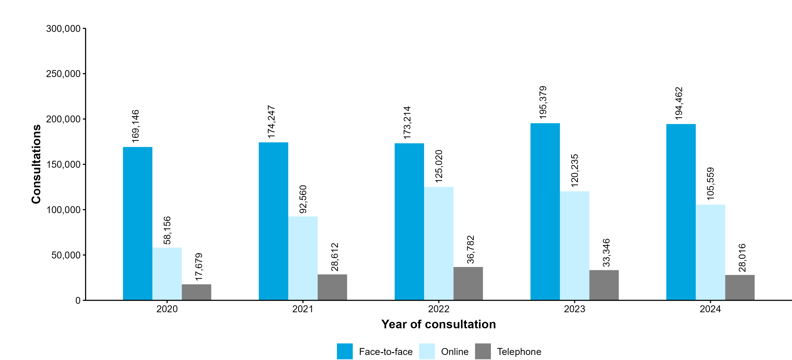
Figure 18: Consultations by service medium: Yorkshire and Humber residents, 2020 to 2024

Slide 27
Information sources
These slides are based on data from the GUMCAD and CTAD surveillance systems (data to the end of calendar year 2024).
GUMCAD is the mandatory surveillance system for STIs and collects data on STI tests, diagnoses and services from all commissioned sexual health services in England.
CTAD provides information about all tests/screens and diagnoses of chlamydia, the most prevalent STI in England, including those that occur in the community. CTAD does not collect information about sexual orientation or country of birth.
Rates, which are not age-restricted unless specifically indicated, are based on mid-year population estimates for 2023, published by the Office for National Statistics in 2023, with the exception of rates by ethnic group which use population estimates by ethnicity from the 2019 census.

Slide 28
Further information
The Field Services was established in 2018 as a national service comprising geographically dispersed multi-disciplinary teams integrating expertise in Field Epidemiology, Real-time Syndromic Surveillance and Public Health Microbiology to strengthen the surveillance, intelligence and response functions of UKHSA.
You can contact your local FS team at YHFS@ukhsa.gov.uk.
Other publicly accessible data can be accessed via:
The gov.uk website:
https://www.gov.uk/government/collections/sexually-transmitted-infections-stis-surveillance-data-screening-and-management#epidemiology
The fingertips tool:
https://fingertips.phe.org.uk/profile/sexualhealth
Additional data may be available to local authority stakeholders via the Data Exchange and secure HIVSTI web portal. Please contact your local Field Services team for more information.

